Slide 1
Protection of the Rights of Children in Latvia
June 8, 2023
Riga

Slide 2
Protection of the Rights of Children – a collective effort
PRIORITY:
In any relations that affect a child, the rights and best interests of the child shall be the priority

Slide 3
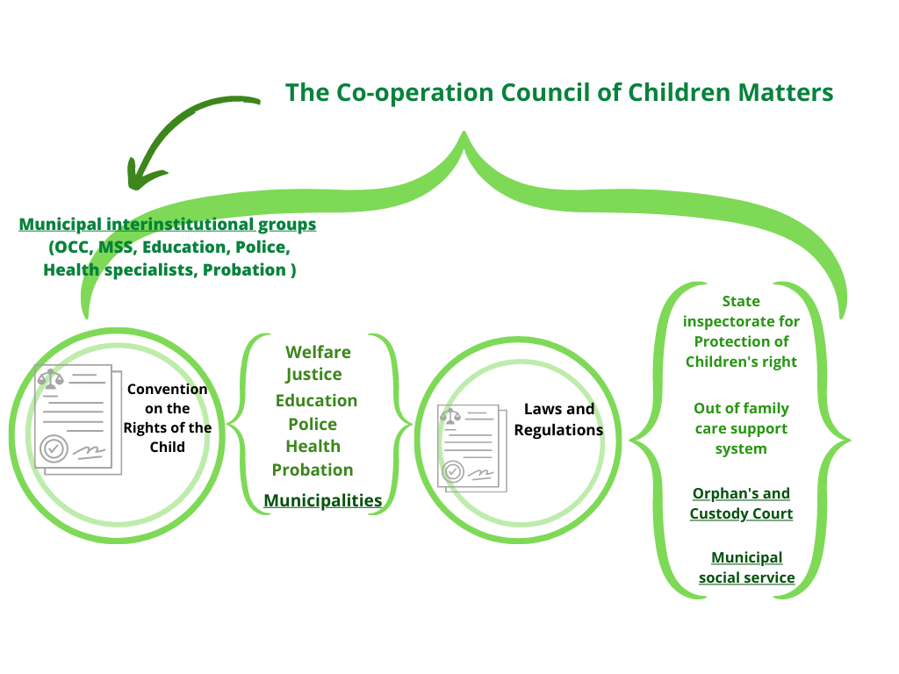
The Child Protection System in Latvia
Notes:
State Inspectorate for Protection of Children’s Rights
Monitoring and control of compliance with regulatory acts;
Supervision and methodical management of orphan
Providing recommendations and cooperation in the field of protection of children's rights
Consulting and support services
Helpline
Barnahus
An Orphan's and Custody Court
defend the personal and property interests and rights of a child or a person under trusteeship;
carry out the necessary activities in order to ensure upbringing of and appropriate care for the child in a family environment;
cooperate with other Orphan's and Custody Courts, the State Inspectorate for Protection of Children's Rights, long-term social care and social rehabilitation institutions and health care and educational institutions, social service offices, police institutions, the State Probation Service, and bailiffs in order to ensure the protection of the rights and interests of a child or a person under trusteeship;
Municipal Social service (MSS)
Social work- including with families and children, with adults, with victims and perpetrators of violence, persons with addictions, and mental health complications etc.;
Development and provision of services
Co-operation Council in Children Matters
An advisory collegial body the objective of which is to promote:
- a unified understanding on the conformity with the principle of priority of a child's interests in local government and State action policies
- coordinated activity of authorities, including municipial cooperation groups, in the protection of children's rights
Chairman of the Council - the Minister for Welfare. Other members:
the Minister for the Interior
the Minister for the Education and Science
the Minister for the Justice
the Minister for the Health
the authorised representative of the Ministry of the Environmental Protcction and Regional Development
the authorised representative of the Ministry of Culture
the authorised representative of the State Chancellery
the Head of State Child Protection Inspectiorate
the Chairman of Latvian Association of Local and Regional Governments
the authorised representative Latvians Children’s Welfare Network
the authorised representative of Association of employees of Latvian Orphan's Courts
Ministry of Justice
The Ministry of Justice is the Central Authority in forced enforcement cases affecting the return of children to the State of residence (On the Hague Convention on Civil Aspects of International Child Abduction)
Out-of-family care support centre
-To provide consultation/support for foster families
-Attract new foster families, guardians, adopters
-Organise training of foster families, potential adopters and since 01.04.2023. guardians
-Develop a support plan for a foster family a child
-Payment of remuneration/benefits
-Fill data in the Information System
Legal framework for children’s right’s protection
UN Convention on the rights of the child (Latvia acceded to the convention in 1992)
The Constitution of the Republic of Latvia
The constitution inter alia defines that the state shall protect rights of the child and provide special support to children who have suffered from violence (this legal provision has been included in the constitution in 1998)
Law on the Protection of the Children’s Right’s (has been adopted in 1998)
The law defines the rights and freedoms of a child as well as well as numerous other principles for the protection of the rights of the child. The law also defines the necessary actions to be taken by the institutions involved in the protection of the rights of the child.
Sectoral laws ensuring the implementation of the rights of the child (Law on Health Care, Law on Social Services and Social Assistance, Law on Orphan’s and Custody Courts, Law on Education etc.)
Cabinet of Ministers Regulations («Regulations Regarding Cooperation of Institutions on the Protection of the Children’s Right’s» etc.)

Slide 4
The Council on the Co-operation on Matters Related to Children
Representatives:
Ministries:
Welfare,
Interior,
Education and Science,
Justice,
Health.
Enviromental Protection and Regional Development,
Culture.
State Chancellery,
Latvian’s Children’s Welfare Network,
Association of employees of Latvian Orphan’s Courts.
Common understanding,
Coordinated activities.
State Child Protection Inspectiorate,
Latvian Association of Local and Regional Goverments.

Slide 5
Alternative Care System:
*26%
26%
*65%
*
*9%
*
9%
*Number of Children in alternative care (5798), % in 2022
Notes:
Long term care services close to the family environment,

Slide 6
Types of Foster Families:

Slide 7
Few Statistics:

Slide 8
Out of Family Care Support Centres
12 NGOs
State funded
Functions:
Consultation/
Support
Training
Data
Support plan
Allowance

Slide 9
Ensuring the protection of the rights of Ukrainian children entering the Latvia without being accompanied by parents
an extraordinary guardian
a person who has been granted the status of a guardian or adopter, the status of a foster family or guest family in Latvia,
A person to whom the accompanied child arrives
a person with whom the unaccompanied child has arrived in Latvia
 | Number of children to whom an extraordinary guardian was appointed
Total number (16 March, 2022 – 26 May, 2023) | 1193
Actual number (on 26 May, 2023) | 420
Guardians receive special financial assistance, including monthly remuneration and child support allowance
All Ukrainian children have equal access as Latvian nationals to state-paid health care, education and preschool and there are special support measures as well.

Slide 10
Future:

Slide 11
THANK YOU!
CONTACT:
Ilze.Kurme@lm.gov.lv

