Slide 1


Centre for European Volunteering
Strengthening, Inspiring and Celebrating Volunteering in Europe since 1992
Riga, 14 March 2025
Gabriella Civico, CEV Director

Slide 2



Slide 3








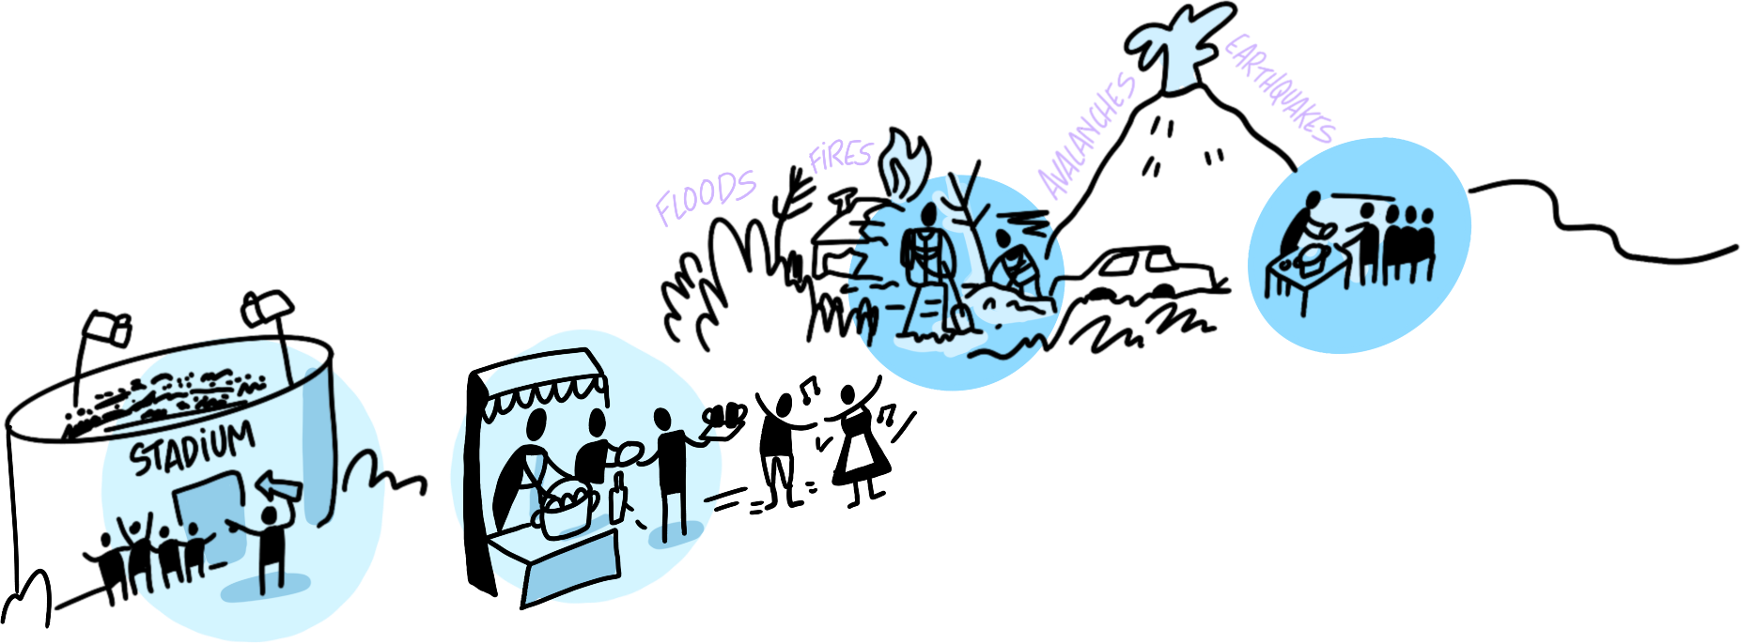

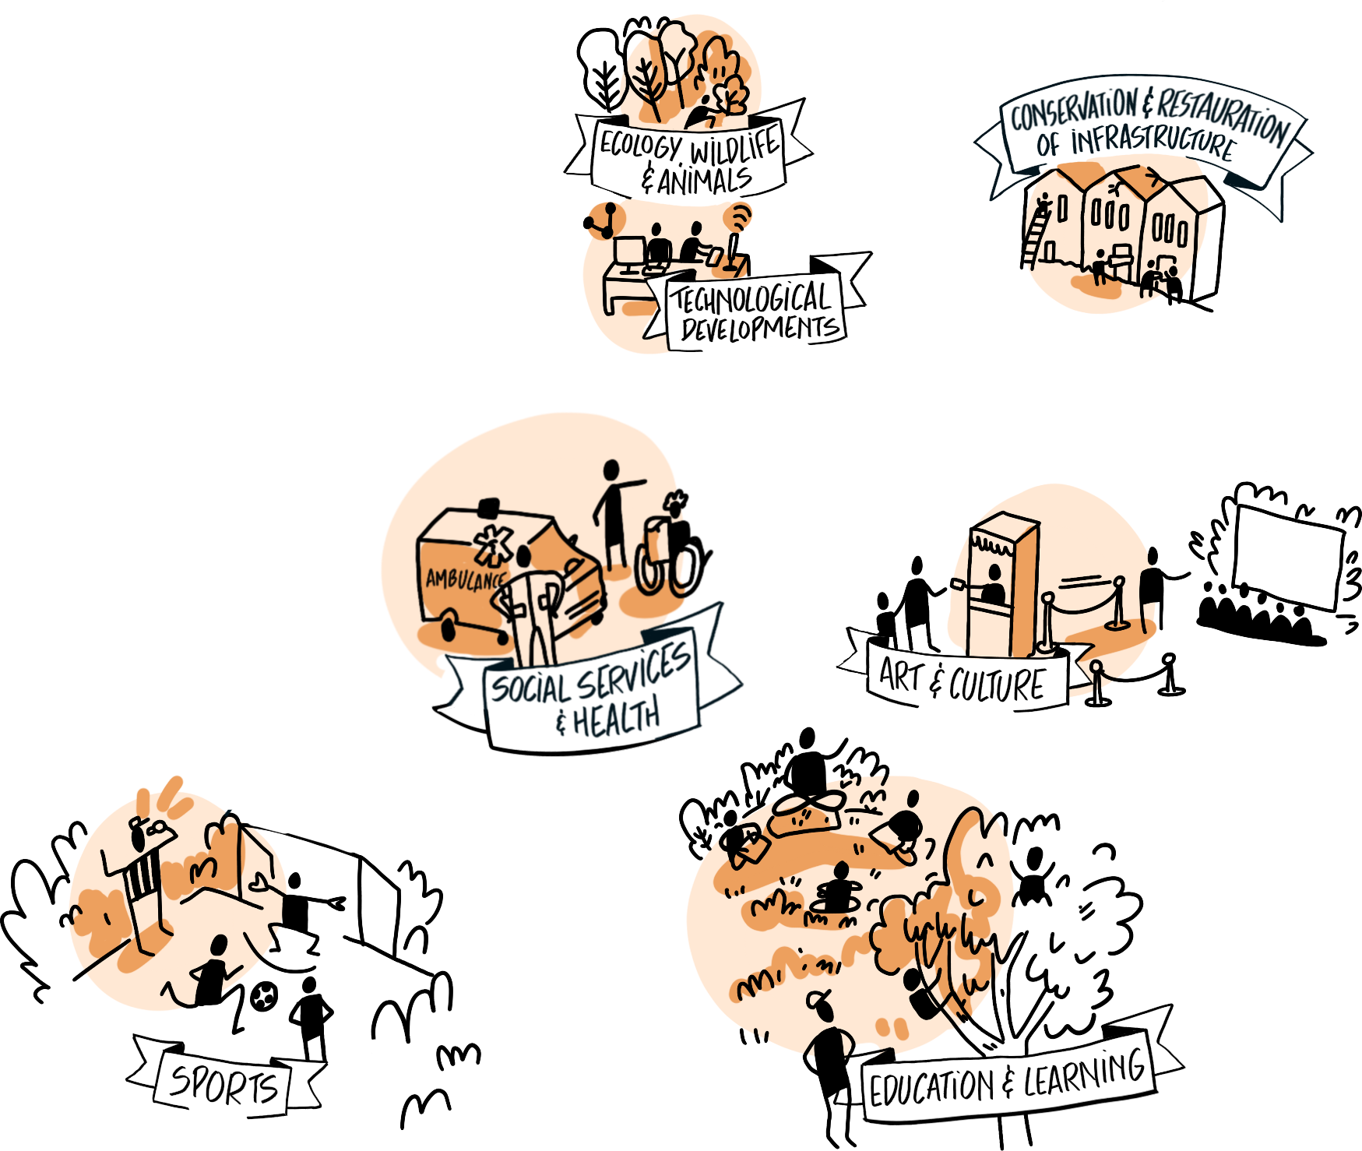










Slide 4

THANK YOU
Follow us on Facebook, Twitter, Youtube and Instagram for more from CEV and our members.
@VolunteeringCEV
@VolunteeringCEV
@volunteeringcev
Centre for European Volunteering CEV
CEV-Centre for European Volunteering
www.europeanvolunteercentre.org

